Slide 1
HUMAN RESOURCE MANAGEMENT
Dr Vibhav Singh
Session 1 & 2

Slide 2
HR Profession
Performance and reward
Work out how much to pay and reward employees
Employment law
Protect the rights of employees
Employee relations
Manage relationships and keep the peace
Recruitment and talent planning
Get the right people in the right jobs
Employee engagement
Make sure employees are happy and motivated
Learning and development
Help employees learn and develop
Organisation development
Make the organisation more effective
HR generalist
Do a mixture of all of the above!
Notes:
There’s something for everyone.
If you’re analytical, you could work out how much people should be paid and rewarded
If you like law, you can work with the laws that protect workers
If you are good at making other people feel listened to and remaining diplomatic and calm in difficult situations, you’d make a great employee relations specialist
Interested in marketing or advertising? Recruitment involves a lot of this, except instead of selling a product, you’re selling the company to people and hiring those who come forward!
Interested in psychology and what motivates people? Employee engagement might be the right path for you.
if you like helping others reach their potential then you could work in learning and development.
Organisation development involves improving businesses by looking at employee behaviour/how the business is organised and how things get done. So if you like solving problems and improving things, OD could be for you!

Slide 3

Top 5 skills of great HR professionals
Interested about how the business works as well as its products, services and customers
Gathering and analysing information to make the right decision
Ability to communicate and influence all kinds of different people
Guided by a sense of moral fairness and willing to challenge unethical decisions
Ability to work through problems with patience and determination
Curious
Decisive thinker
Skilled Influencer
Ethical integrity
Problem solver
Notes:
Curious – HR professionals have to know about business in general but also all about their own organisations as they have to make decisions with an understanding of what is going to be affected.
Decisive thinker – the HR industry is becoming increasingly driven by data, so its important that you know how to manage that and use it to make good decisions
Skilled influencer – in business you have to sell your ideas, and HR is no different.
Ethical integrity – If you work in HR, you need to lead by example. You should act with integrity and impartiality and have the courage to defend your views
Problem solver – there’s no doubt you’ll encounter plenty of issues, and because you’re dealing with people, they’ll never be clear cut. You need patience to work through challenges and the determination to push ahead
Remember – these can all be learned behaviours

Slide 4

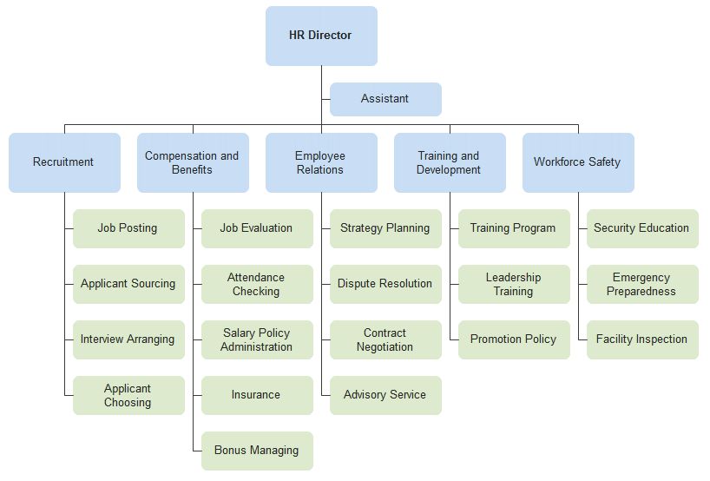

Organizing HR responsibilities/ HR Department
Size of HR reflects the company’s size

Slide 5

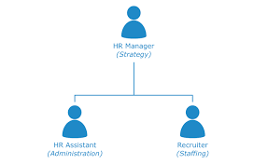

Organizing HR responsibilities
Size of HR reflects the company’s size

Slide 6
LINE MANAGERS AND STAFF MANAGERS

Slide 7
Line authority and Staff authority
Line Authority : authority exerted by HR manager by directing the activities of the people in his/her department and in service area
Authority
The right to make decisions, direct others work and give order
Staff Authority : gives manager the right to advise other managers and employees

Slide 8
LINE & STAFF MANAGER
Staff managers have the right to advise others in organization
Line managers have direct authority to issue orders

Slide 9
Line and staff manager
Line
Vice President (sales)
Sales Director (sales)
To prepare Sales Plan for the financial year
Staff
Human Resource Manager
Plant Manager
Suggests to use a particular selection test

Slide 10
HR Duties – Line Manager
Job placement
Orientation & Training
Performance
Cooperation
Labor costs
Development
Sales Manager & HR Duties
Needs to recruit right Area Sales Manager & Sales officers
Need to train and develop the ASM to meet the sales Target
Constant monitoring of target attainment through focus on improvement of job performance
Controlling the labor cost

Slide 11
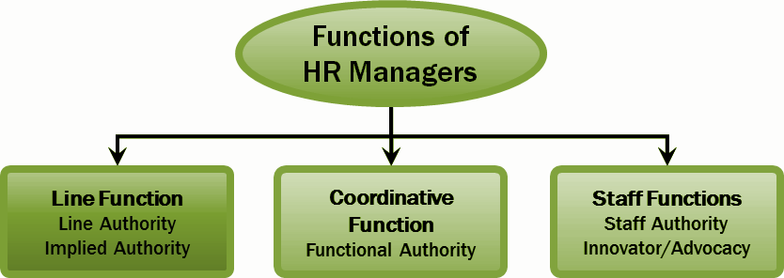
Human Resource Manager Duties

Slide 12
Human Resource Manager Duties
A line function : directs the activities of the people in his or her own department, and perhaps in related areas (like the plant cafeteria).
A coordinative function: coordinates personnel activities (or functional control). Ensures that line managers are implementing the firm’s human resource policies and practices (for example, adhering to its sexual harassment policies).
Staff (assist and advise) functions : Assisting and advising line managers is the heart of the human resource manager’s job. He or she advises the CEO on company’s strategic options.
(a) Innovator role (b) Employee advocacy (c) implied authority

Slide 13
Reorganizing HRM function
Transactional HR teams provide specialized support in day-to-day HR activities. Ex : Infosys internal BPO
Corporate HR teams - assist top management in top-level issues such as developing the personnel aspects of the company’s long-term strategic plan
Embedded HR teams - HR generalists (“relationship managers” or “HR business partners”) assigned to functional departments like sales and production
Centers of expertise - Specialized HR consulting firms within the company

Slide 14
Questions
Anil is authorized to direct the work of subordinates and is responsible for accomplishing the organization's tasks. Anil is most likely a ________.
A) training specialist
B) staff manager
C) line manager
D) recruiter

Slide 15
Questions
All of the following are ways in which an HR manager most likely assists and advises line managers EXCEPT ________.
A) administering health and accident insurance programs
B) representing employees' interests to upper management
C) making strategic business planning decisions
D) hiring, training, and evaluating employees

Slide 16
HR Metrics & Benchmarking
Being able to measure what you are doing is an integral part of the HR strategy process
Metrics for more profitable organization
HR-to-Employee ration
Cost-per-hire
Annual overall Turnover Rate
Time to fill vacant position
Compensation Data
Annual Salary increase
Target bonus for executives
Target bonus for non-executives

Slide 17
HR Metrics & Benchmarking
Benchmarking and Need Analysis
How are we doing in relation to something
SHRM’s benchmarking service enables employers to compare their own HR metrics with those of others.
Strategy and Strategy-based Metrics
HR metric may not reveal the extent to which your firm’s HR practices are supporting its strategic goals
For hotel: 100% employee testing, 80% guest return, % of incentive pay
Data Mining- set of activities used to find new, hidden or unexpected patterns in data.

Slide 18
HR Metrics & Benchmarking
HR Audits : An analysis by which company measures where it stands and determines what it has to accomplish to improve its HR function.
It helps to identify and reveal strengths and weakness in the HR system
HR audit is carried out generally once in a year
Areas included in audit are (to name a few):
Roles and Headcount (includes JDs)
Compliance with Legislations
Recruitment and selection (tools)
Compensation (Policies, incentives, survey procedures)

Slide 19
High-Performance Work Systems
Are set of HRM policies and practices that together produce superior employee performance
High performing companies,
recruit more job candidates
use more selection tests
spend many more hours training employees
Sample HR Practices | Low performance Company | High-performance company
Number of qualified applicants per position (Recruiting) | 8.24 | 36.55
Percentage hired based on a validated selection test | 4.26 | 29.67
Firms Performance Employee Turnover Sales per employee | 34.09 $158.01 | 20.87 $617,576

Slide 20
HR Audit
According to Eric G. Flamboltz, “Human Resource Audit is a systematic assessment of the strengths, limitations, and developmental needs of its existing human resources in the context of organisational performance.”

Slide 21
Need for HR Audit
HR audit is performed to determine whether HR objectives are aligned with organisational objectives and employees are committed towards achieving the organisational goals and objectives.
HR audit is needed to determine whether employees follow organisational standards, maintain discipline, and work as per the organisation’s policies.
HR audit is needed to review the effectiveness of various HR programs, such as selection and recruitment, training and development, and performance appraisal, and improve them.
HR audit helps to determine whether the HRM function is in compliance with the national and state HR laws.
It focuses on identifying gaps or drawbacks in the implementation of policies, rules, regulations, and other practices of the HR department and recommending corrective measures.
HR audit aims to check all possible documentation with regards to performance appraisal reports, data related to the functions of the HR department, manager feedback reports on employees’ performance, etc.

Slide 22
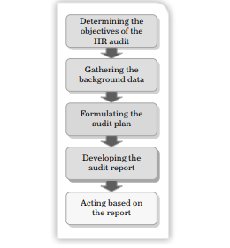
HR Audit Process

Slide 23
HR Audit Process
Determining the objectives of the HR audit: In this step, the objectives of conducting HR audit are determined. These objectives can be to finding out whether HR objectives are aligned with organisational objectives; the HR practices of the organisation effective; and so on.
Gathering the background data: In this step, the auditor collects data about an organisation’s internal and external business environment.
Formulating an audit plan: In this step, the auditor prepares a plan on how to start, where to start, what sources to be used, etc. In addition, this step involves deciding the overall budget of the HR audit process and the number of people required for conducting the audit.
Developing the audit report: This report highlights the strengths of the existing HR system of the organisation and the areas that require improvements.
Acting based on the report: Organisations take actions based on the recommendations given by the HR auditor. The actions can be redefining HR strategies, restructuring the HR department, changing HR policies, etc.

Slide 24
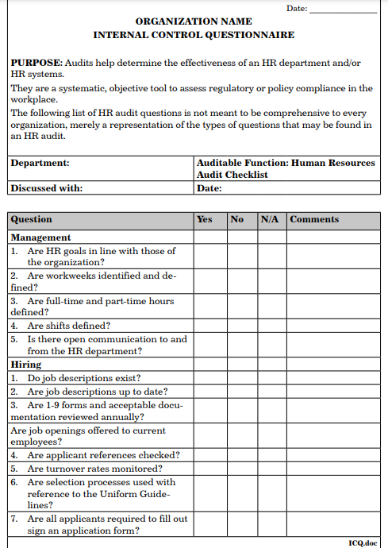

Slide 25
Limitations of HR Audit
HR audit can lack uniformity as auditors tend to follow different auditing standards and guidelines. This is because there is no set standard or principles for HR audit.
Sometimes HR personnel fail to provide relevant information, which leads to inaccurate and ineffective audit process.
HR audit can turn to subjective in nature when there is a lack of statistical data.
HR auditors may lack the required skills and knowledge, which may lead to a failure of the audit process.
HR auditors sometimes fail to recognise valuable inputs from senior HR personnel which might be useful for the audit process.

Slide 26
HR Accounting
According to Eric Flamholtz, “Human resource accounting is the measurement of the cost and value of the people for the organisation.”

Slide 27
Need for HR Accounting
HRA helps in estimating the expenses on human resources, listing the expenses correctly in the book of accounts, and reporting the record of expenses in financial statements.
HRA provides information about cost and value of human resource to managers. This helps them to take decisions regarding recruitment, selection, and training and development of human resource.
It provides information for making decisions related to the acquisition, allocation, and development of human resource to achieve cost-effectiveness.
It allows managers to monitor the utilisation of human resource.
It provides a basis of human asset control, that is, whether the asset is appreciated, depleted, or conserved.

Slide 28
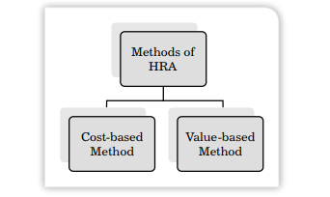
Methods of HR Accounting
Cost-based method: This refers to the total cost incurred by an organisation on employees starting from their recruitment to separation from the organization
Value-based method: This method is used to determine the value of human resources and their contribution to the organisations’ profits in monetary terms.

Slide 29
Limitations of HR Accounting
HRA doesn’t have any set accounting standards for measuring human resource value. Thus, organisations follow their own HRA standards to measure the values of human assets. This difference in approaches in organisations leads to non-comparison of values of human assets.

